Slide 1
AquaSphere Feeding Cycle Database
Optimized Database Schema and ER Diagram

Slide 2
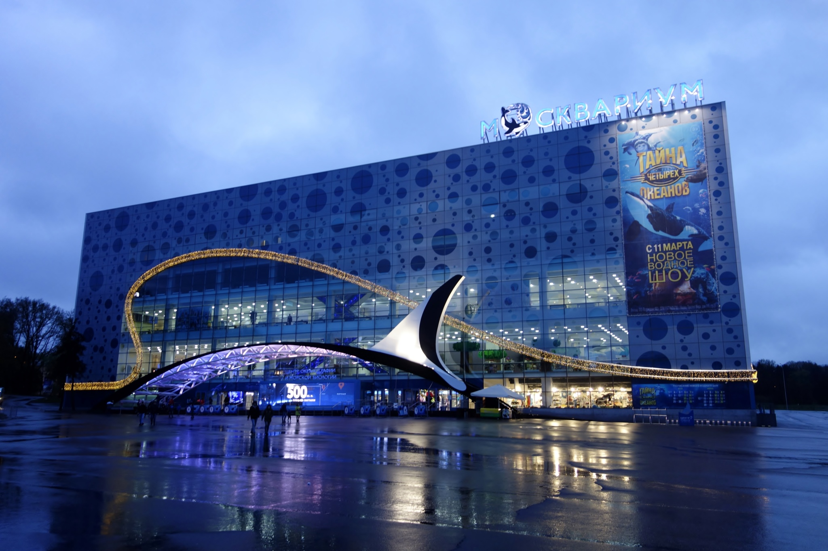

Slide 3
Abstract
The Aquasphere SQL Project simulates a database for an underwater research facility, managing data on facilities, scientists, marine species, research projects, and observations. It involves creating and interlinking tables, inserting sample data, and developing SQL queries for data retrieval and manipulation. The project showcases efficient data management, enabling operations like counting scientists per facility, retrieving project details for specific species, and updating records. It serves as a practical example of using SQL in a scientific research context, demonstrating the power and flexibility of relational databases.

Slide 4
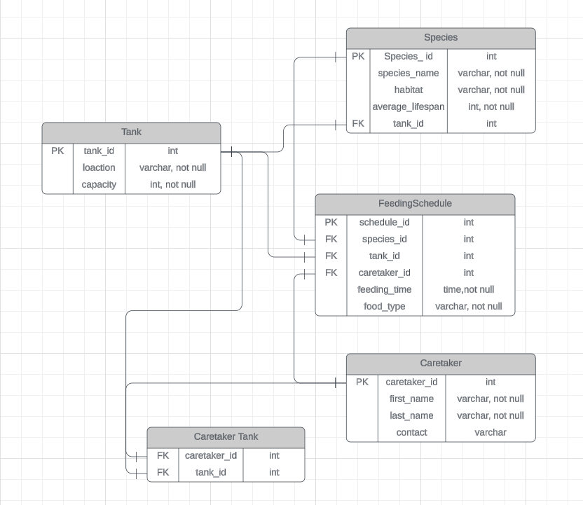
ER Diagram for the schema’s AquaSphere

Slide 5
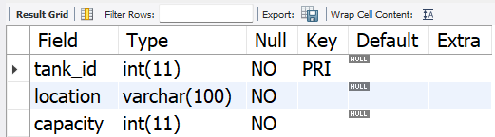
Structure of Tank Table
Syntax: DESC Tank;
Output:

Slide 6
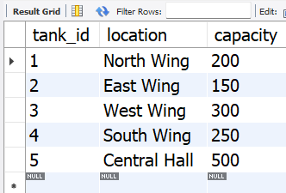
Content of Tank Table
Syntax: SELECT * FROM Tank;
Output:

Slide 7
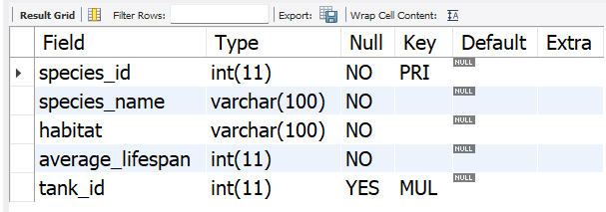
Structure of Table Species
Syntax: DESC species;
Output:

Slide 8
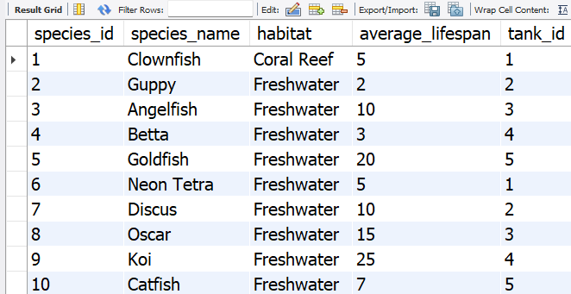
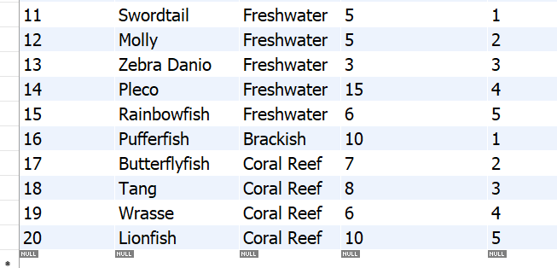
Contents of the Species table
Syntax: SELECT * FROM Species;
Output:

Slide 9
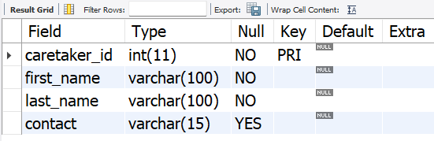
Structure of Caretaker Table
Syntax: DESC Caretaker;
Output:

Slide 10
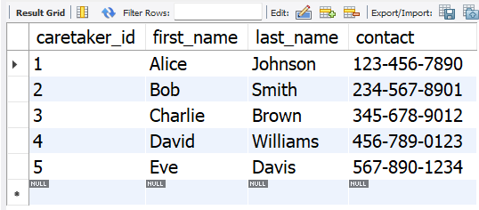
Contents of the Caretaker Table
Syntax: SELECT * FROM Caretaker;
Output:

Slide 11
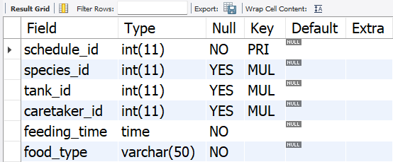
Structure of Feeding Schedule Table
Syntax: DESC FeedingShedule;
Output:

Slide 12
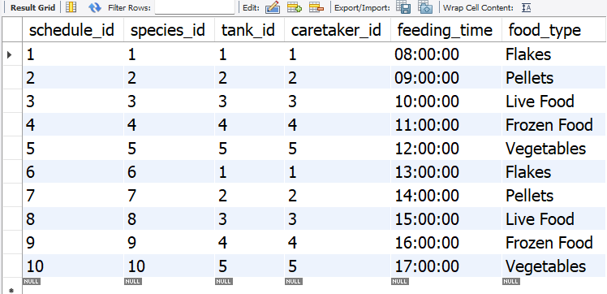
Contents of Feeding Schedule Table
Syntax: SELECT * FROM FeedingSchedule;
Output:

Slide 13
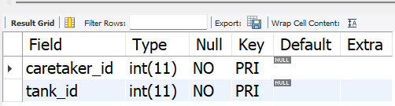
Structure of Caretaker Tank table
Syntax: DESC Caretakertank;
Output:

Slide 14
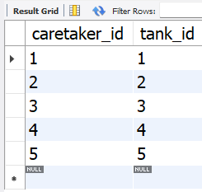
Contents of Caretaker Tank Table
Syntax: SELECT * FROM Caretakertank;
Output:

Slide 15
SUBQURIES

Slide 16
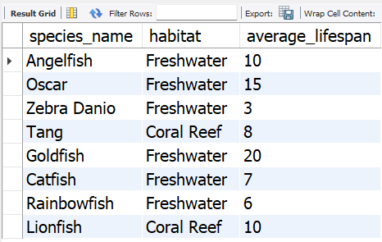
Retrieve Species in Tanks with Capacity Greater Than 250
Syntax:
SELECT species_name, habitat, average_lifespan FROM Species WHERE tank_id IN ( SELECT tank_id FROM Tank WHERE capacity > 250);
Output:

Slide 17
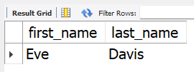
Retrieve Caretakers Assigned to the Largest Tank
Syntax:
SELECT first_name, last_name FROM Caretaker WHERE caretaker_id IN ( SELECT caretaker_id FROM CaretakerTank WHERE tank_id = ( SELECT tank_id FROM Tank ORDER BY capacity DESC LIMIT 1 ));
Output:

Slide 18

Retrieve the Species with the Longest Average Lifespan
Syntax:
SELECT species_name, habitat, average_lifespan FROM Species WHERE average_lifespan = ( SELECT MAX(average_lifespan) FROM Species);
Output:

Slide 19
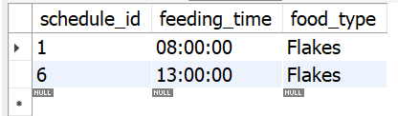
Retrieve Feeding Schedules for Species in 'North Wing' Tanks
Syntax:
SELECT schedule_id, feeding_time, food_type FROM FeedingSchedule WHERE tank_id IN (SELECT tank_id FROM Tank WHERE location = 'North Wing');
Output:

Slide 20
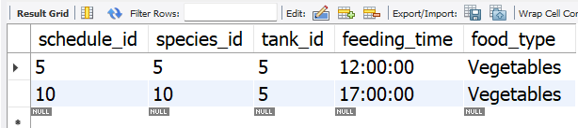
Retrieve the Feeding Schedules for Species in the Largest Tank
Syntax:
SELECT schedule_id, species_id, tank_id, feeding_time, food_type FROM FeedingScheduleWHERE tank_id = ( SELECT tank_id FROM Tank ORDER BY capacity DESC LIMIT 1);
Output:

Slide 21
JOINS

Slide 22
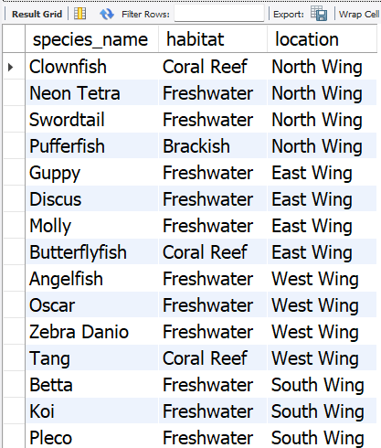
Join Query to Retrieve Species and Their Corresponding Tanks:
Syntax:
SELECT s.species_name, s.habitat, t.location FROM Species s INNER JOIN Tank t ON s.tank_id = t.tank_id;
Output:

Slide 23
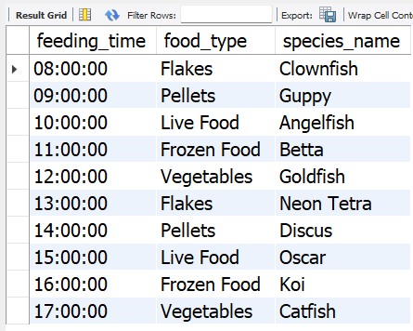
Join Query to Get Feeding Schedule with Species Names:
Syntax:
SELECT fs.feeding_time, fs.food_type, s.species_name FROM FeedingSchedule fs INNER JOIN Species s ON fs.species_id = s.species_id;
Output:

Slide 24
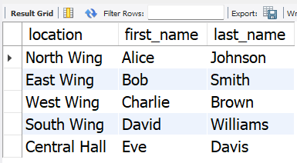
Join Query to Get Caretakers Responsible for Feeding Fish in Each Tank:
Syntax:
SELECT t.location, c.first_name, c.last_name FROM Tank t JOIN CaretakerTank ct ON t.tank_id = ct.tank_id JOIN Caretaker c ON ct.caretaker_id = c.caretaker_id;
Output:

Slide 25
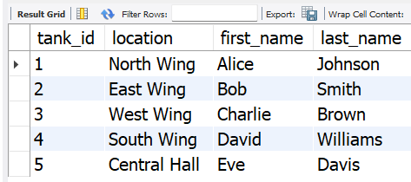
Join Query to Retrieve Caretakers and Their Assigned Tanks (Left Join)
Syntax:
SELECT t.tank_id, t.location, c.first_name, c.last_name FROM Tank t LEFT JOIN CaretakerTank ct ON t.tank_id = ct.tank_id LEFT JOIN Caretaker c ON ct.caretaker_id = c.caretaker_id;
Output:

Slide 26
Join Query to Retrieve Feeding Schedules with Caretaker Details (Right join)
Syntax:
SELECT FeedingSchedule.schedule_id, FeedingSchedule.species_id, FeedingSchedule.tank_id, FeedingSchedule.feeding_time, FeedingSchedule.food_type, Caretaker.first_name, Caretaker.last_name FROM CaretakerRIGHT JOIN FeedingSchedule ON Caretaker.caretaker_id = FeedingSchedule.caretaker_id;

Slide 27
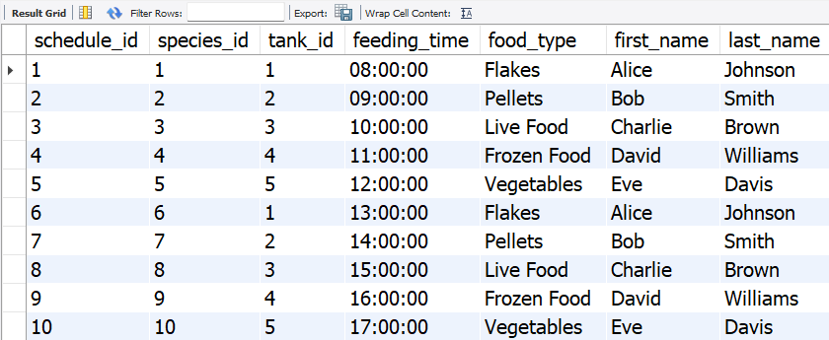
Output:

Slide 28
Prepared by
Ashwin Varman
IT VEDANT
T318- Master’s in Data
Science and Analytics with AI

Slide 29
Thankyou

